Slide 1
Python and SQL

Slide 2
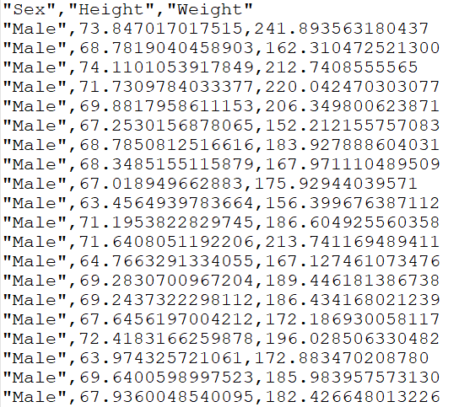
Data Persistence
At this stage, you can store and retrieve text-based data using Python
An effective way to store small amounts of data
CSV or Tab-separated value files
Not practical for very large data sets
Want to use a Database!

Slide 3
Databases
A database is an organised collection of structured data
Most commonly arranged into a series of tables
This approach can be more efficient and effective than many alternative approaches
A large number of database management systems are available – we will be using SQLite3 in this module.

Slide 4

What is SQLite3?
https://www.sqlite.org/index.html
File-based relational database using the Structure Query Language to create, read, update, and delete data
It is a lightweight ‘C’ library implementing the SQL engine/query language
Various languages, including Python, have wrappers to use this library
Often used where full-fledged server-hosted RDMS is impractical/unnecessary, but relational database functionality is desirable
Examples SQLite3 real-world use (source: https://www.sqlite.org/famous.html)
Adobe for several applications
Android OS & Apple iOS mobile platforms
BOSCH multimedia systems built into automobiles by various manufacturers
Numerous smart TVs and set-top devices
Notes:
RDMS - relational database management software

Slide 5
Benefits of SQLite3
Relational Database features without the hassle of managing a server – it is file-based
It is portable – it is file-based, allowing you to move the database around easily
Developing and testing applications requiring relational database is much easier – all data and files are local

Slide 6
Sample of SQLite3 limitations
No user management – the application itself would have to define this
Database size limited to 281 terabytes
Not so good for true Big Data storage and analysis
Limited to 64 table joins – unlikely to be a concern for us!
Not being server-based, shared-access is difficult – you’d have to write your own server application!
Some useful features may be missing compared to other DBMS
When to use SQLite3 guide: https://www.sqlite.org/whentouse.html

Slide 7
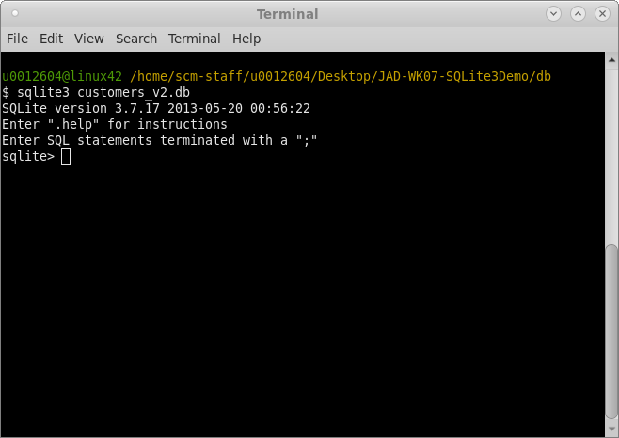
Useful support tools
GUI
Command-line
DB Browser for SQLite (Free)
https://sqlitebrowser.org/dl/
DBeaver (Free academic licence for Enterprise Edition – signup required)
https://dbeaver.com/download/enterprise/
SQLite3 Editor extension for Visual Studio Code
sqlite3

Slide 8
Before we start…
SQL and Databases are a very deep subject
This week focusses on the fundamentals, with more to come
A lot of detail left out for brevity!
Highly recommended you do some additional study outside of this week’s lecture and labs
W3Schools is an excellent resource – make sure you look at SQLite3 examples!

Slide 9
SQL in a Python Application

Slide 10

SQLite3 for Python
SQL databases are far too complex to read in like a text file
Instead, Python programs must open a connection to the database and query it to access and manipulate the data
This process is complex, but Python has a built-in library for SQLite3

Slide 11
Connection
Opening an SQLite connection in Python is done through the sqlite3.connect(…) function
Pass in the database file as the argument (usual filepath rules apply)
As the connection will be a live (and very expensive) resource, you should use with keyword
If the database doesn't exist when opening a connection, this will also create it!
import sqlite3
with sqlite3.connect("example.db") as conn:
cursor = conn.cursor()
# Database queries and operations...
conn.commit()

Slide 12
Cursor
Once a connection is open, we need to create a cursor to read and manipulate our database
This is achieved through using the .cursor() function of the open connection
All the operations we will apply to our database will be executed through this cursor
But what operations can we perform?
import sqlite3
with sqlite3.connect("example.db") as conn:
cursor = conn.cursor()
# Database queries and operations...
conn.commit()

Slide 13
SQL Queries
Getting data back

Slide 14

SQL
Databases that use SQL are typically interacted with through statements and queries
Statements and queries are SQL commands that will accomplish some goal or process
Similar to programming languages like Python, but looser syntax

Slide 15
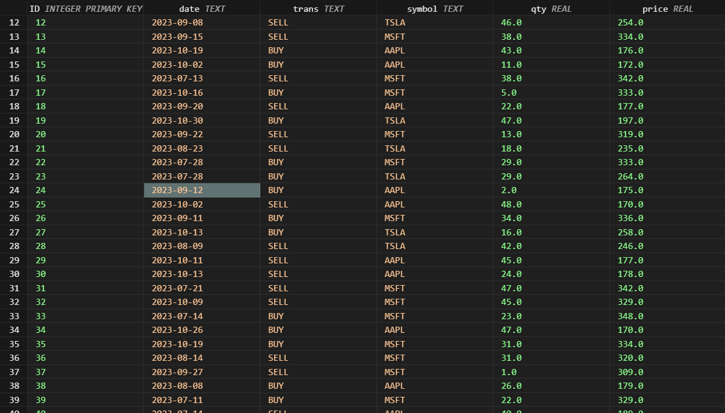
Tables
Tables are the usual way a database stores and models data
Visually similar to a spreadsheet
These tables are a collection of columns describing the structure of the data to be stored
With each row representing one record of data

Slide 16
Tables
Each column typically includes a datatype
Text, integer, real, etc.
Not a perfect match with Python
But in SQLite3, typing is not required, and very forgiving
But do your best to follow the types expected by each column – it makes retrieval and analysis of data much simpler

Slide 17
Primary Keys
Each row in the table should also have some kind of unique identifier.
A Primary Key.
This identifier is used to make each entry in the database unique – extremely important with multiple tables and duplicate data.
While some datasets will have a useful identifier as part of it already…
Student number
Reference number
…other datasets will require a primary key to be introduced.
With a numeric ID as the most common approach

Slide 18
Select queries
Now that we understand the structure of our data, how do we use it?
For retrieving data from a database, we use a SELECT query
Retrieves data from the database and presents it as a new table
Basic pattern is very straightforward:
SELECT – identify the columns you want to retrieve
FROM – name the table (or tables) where the columns are
WHERE – add an optional condition to filter the data

Slide 19
Select all
The most basic form of SELECT query is one that will retrieve all rows and columns from a database
* is the “wildcard” operator – it will match with any value, which will include all columns
But how do we use it in Python?
SELECT *
FROM stocks

Slide 20
Execute function
The execute function of a cursor will apply a specified SQL command or query to the database
The SQL is passed into the execute function as a String
This string is simply just the SQL query itself – no changes
But note that the query itself may contain Strings as part of it!
Use “ and ‘ to denote the different strings if needed

Slide 21
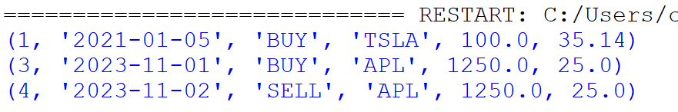
import sqlite3
with sqlite3.connect("example.db") as conn:
cursor = conn.cursor()
# Store the results of the query to be used later
res = cursor.execute("SELECT * FROM stocks")
for row in res:
print(row)
conn.commit()

Slide 22
Configuring Connection
conn.row_factory = sqlite3.Row
When querying the database to retrieve data, you may want to include this code after opening the connection.
This line of code is a command that will configure the database to return sqlite3 Rows when queried
Can be easier to use compared to default responses (tuples)
Allows you to retrieve data by column name – equivalent to dictionaries

Slide 23
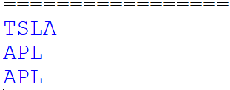
import sqlite3
with sqlite3.connect("example.db") as conn:
conn.row_factory = sqlite3.Row
cursor = conn.cursor()
# Store the results of the query to be used later
res = cursor.execute("SELECT * FROM stocks")
for row in res:
print(row[“symbol”])
conn.commit()

Slide 24
Selecting data with WHERE
While wildcard selects are great for checking the whole database, they’re aren’t really practical
Imagine a database with 10 columns and thousands of rows
Only want some of this data
Can limit the columns by naming them in select
And can filter the rows with WHERE
import sqlite3
with sqlite3.connect("example.db") as conn:
conn.row_factory = sqlite3.Row
cursor = conn.cursor()
# Store the results of the query
res = cursor.execute(
"SELECT symbol FROM stocks")
for row in res:
print(row)
conn.commit()

Slide 25
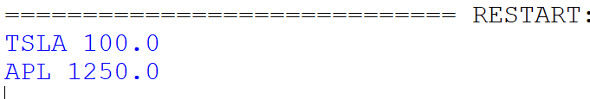
import sqlite3
with sqlite3.connect("example.db") as conn:
conn.row_factory = sqlite3.Row
cursor = conn.cursor()
# Store the results of the query to be used later
res = cursor.execute(“/
SELECT trans, symbol, qty/
FROM stocks/
WHERE trans=‘BUY’")
for row in res:
print(row[“symbol”], row[“qty”])
conn.commit()

Slide 26
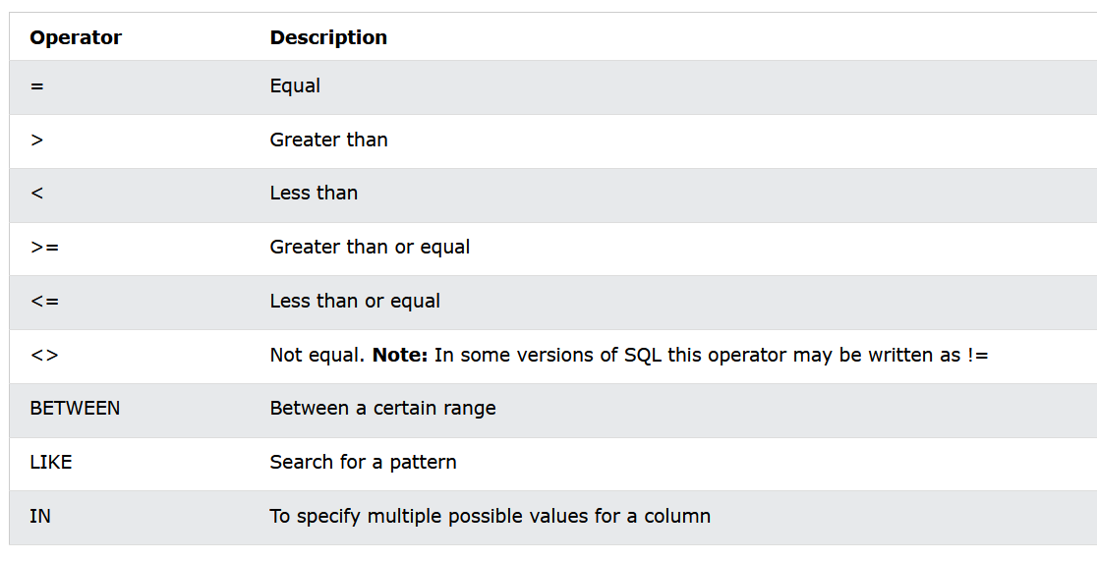
WHERE supports a range of operations to filter your results
Many have an equivalent in Python, but may not be the same keywords
Spend some time to experiment and see how the operators work

Slide 27
SQL Functions
Finally, SQL provides some functions to simplify common operations
Min, Max, Sum, Average
But let’s look at Count for an example!
import sqlite3
with sqlite3.connect("example.db") as conn:
conn.row_factory = sqlite3.Row
cursor = conn.cursor()
# Store the results of the query
res = cursor.execute(
"SELECT symbol FROM stocks")
for row in res:
print(row)
conn.commit()

Slide 28
import sqlite3
with sqlite3.connect("example.db") as conn:
conn.row_factory = sqlite3.Row
cursor = conn.cursor()
query = "SELECT COUNT(symbol) as c FROM stocks WHERE trans='BUY'"
res = cursor.execute(query)
for row in res:
print(row["c"])
conn.commit()
An alias for the result of COUNT, so we can refer to it later in the code
Note the use of two different types of quotation marks!
One set to denote the SQL statement and another for the strings in the values

Slide 29
DDL
Laying the foundations

Slide 30
DDL
Data Definition Language refers to SQL commands that configure and manage the database design
Creating schemas (collections of tables)
Configuring key properties
And creating, managing, updating or deleting (dropping) tables

Slide 31
Creating Tables
We know what tables are – so how do we design them?
Identify what the table needs to represent
Identify what attributes the data has
The types of these attributes
Any special properties of these attributes
Identify a primary key (or introduce one)
And then we run a CREATE TABLE command

Slide 32
CREATE TABLE
CREATE TABLE stocks(
ID integer PRIMARY KEY,
date text,
trans text,
symbol text,
qty real,
price real
)
The SQL command to create a table consists of the CREATE TABLE keywords followed by the name of the new table.
Columns are listed in brackets as <name> <type> <modifiers>
separated by commas
So we have our query – how do we execute it in Python?

Slide 33
import sqlite3
with sqlite3.connect("example.db") as conn:
cursor = conn.cursor()
# For this test script, we'll DROP the table so
# that we can CREATE it again.
cursor.execute("DROP TABLE IF EXISTS stocks")
cursor.execute('''
CREATE TABLE stocks(
ID integer PRIMARY KEY,
date text,
trans text,
symbol text,
qty real,
price real)
''')
conn.commit()

Slide 34
Executing statements
For statements that create, add or modify, you just need to use execute – the returned value doesn’t matter
You can run also multiple commands in sequence
Once your commands are completed, you must commit the changes to the Database
<connection>.commit()
import sqlite3
with sqlite3.connect("example.db") as conn:
cursor = conn.cursor()
# For this test script, we'll DROP the table so
# that we can CREATE it again.
cursor.execute("DROP TABLE IF EXISTS stocks")
cursor.execute(‘‘’
CREATE TABLE stocks(
ID integer PRIMARY KEY,
date text,
trans text,
symbol text,
qty real,
price real)
''')
conn.commit()

Slide 35

Queries
Our database is now designed, with all required tables present
But the tables are all empty
Not very useful – we want to store our data
So how do we do this?

Slide 36
DML
Put the data in the table

Slide 37
DML
Where DDL deals with the structure of the database itself…
…Data Manipulation Language focusses on the management of the data within it
DML focusses on the insertion, updating, and deletion of data in the tables
We already have a table – lets add some data!

Slide 38
Insert statements
To insert data into a table, you need to create an INSERT statement
This statement specifies the table you want to add the data to and the values you want to insert
If you supply data to all columns in a single statement, you don’t need to specify the columns themselves
INSERT INTO stocks
VALUES (
1,
'2021-01-05',
'BUY',
'TSLA',
100,
35.14
)

Slide 39
import sqlite3
with sqlite3.connect("example.db") as conn:
cursor = conn.cursor()
cursor.execute(
"INSERT INTO stocks
VALUES (1, '2021-01-05', 'BUY', 'TSLA', 100, 35.14)")
conn.commit()

Slide 40
Insert statements
We can also create a query that uses parameters instead of hardcoded values
Since the query is string, we could use String formatting
But this will introduce security flaws if used with user input
Instead, we use placeholders
import sqlite3
with sqlite3.connect("example.db") as conn:
values = (2, ‘2023-11-02', ‘SELL', 'TSLA', 100, 47.21)
cursor = conn.cursor()
cursor.execute(
"INSERT INTO stocks
VALUES (?, ?, ?, ?, ?, ?)“, values)
conn.commit()

Slide 41
More examples
Stocks and Trees

Slide 42
Any Questions?

